Slide 1
The all-in-one monetization platform for creators and brands

Slide 2
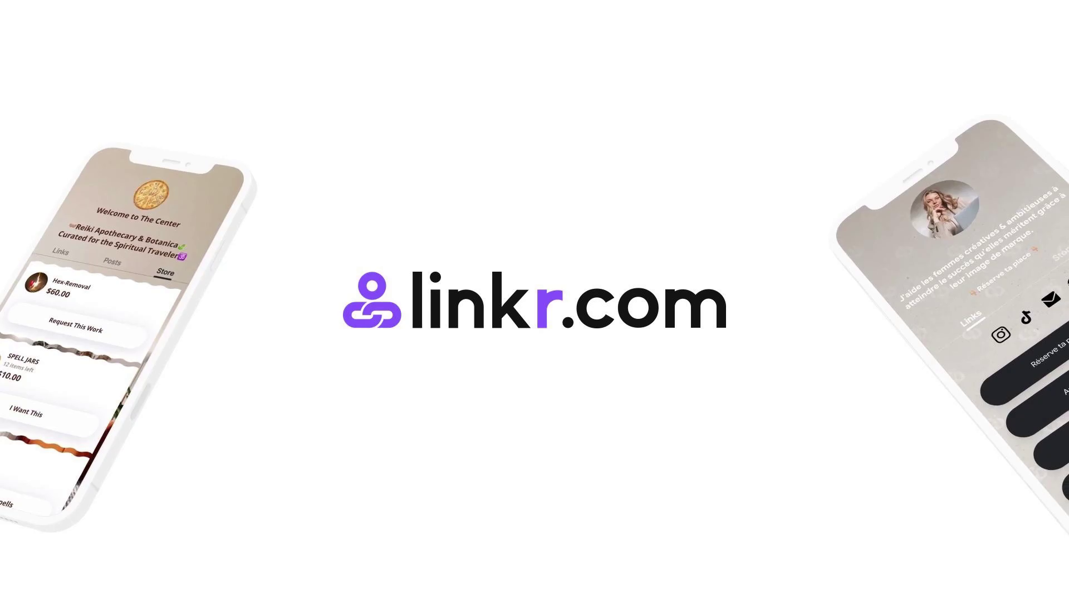
About Us Get to know Linkr via video
Click to view: https://linkr.it/Video

Slide 3
Problems Creator: scattered traffic and solutions
Limited platforms to conveniently monetize their social media following (costly)
Lack of channels to easily display and sell goods
Difficult to keep track of and manage traffic from different social media platforms
Hard to maintain and engage their followers (community or club)
For creators, less is more
Notes:
Gumroad/Discord/OnlyFans/Linktree

Slide 4

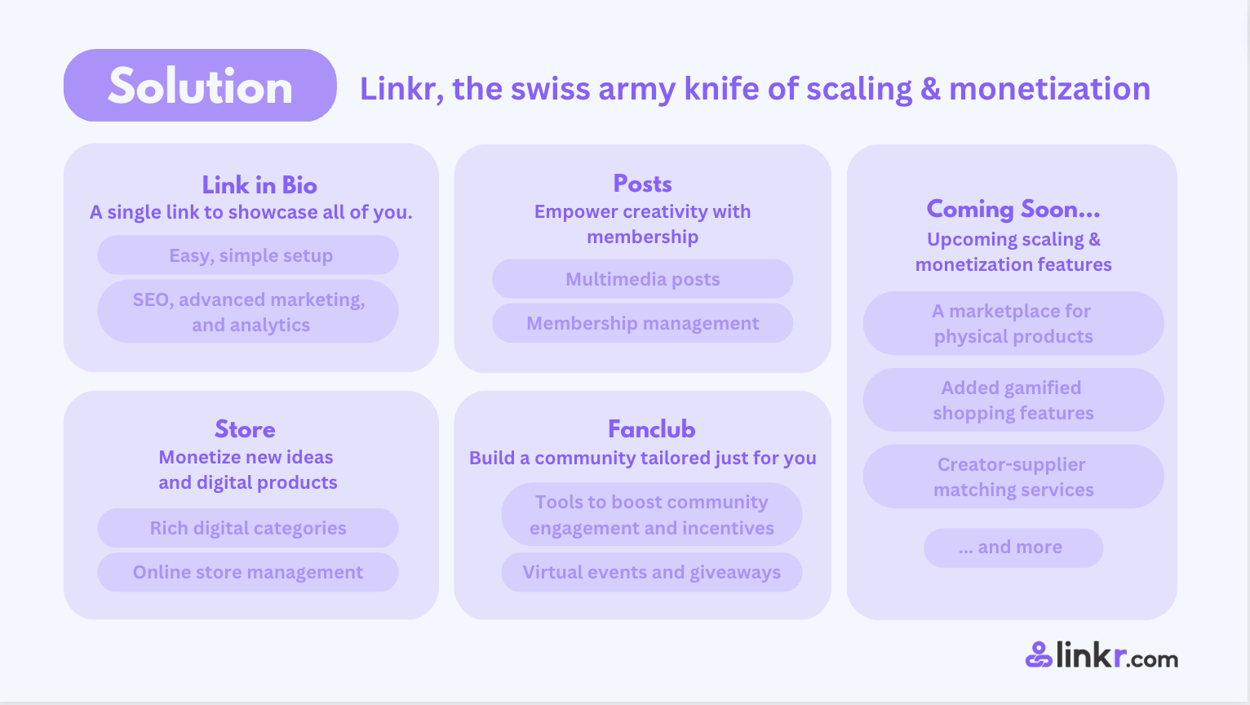
Solution Linkr, all-in-one power of scaling & monetization
Link in Bio
Membership
more to come
A single link to showcase all of you
Empower creativity with membership
more to come
- A marketplace for
physical products
- Added gamified
shopping features
- Creator-supplier
matching services
- Creator-supplier
matching services
Easy, simple setup
Multimedia posts
Built-in marketing Event tools
SEO & advanced marketing
Membership management
Added gamified shopping features
Store
Community
Creator-merchant matchmaking services
Monetize new ideas
and digital products
Build a community tailored
just for you
Growth campaign for socials
Rich digital categories
Tools to boost community engagement and incentives
Physical product catalog
Online store management
Virtual events and giveaways

Slide 5
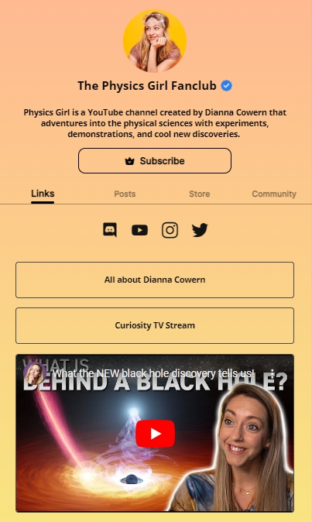
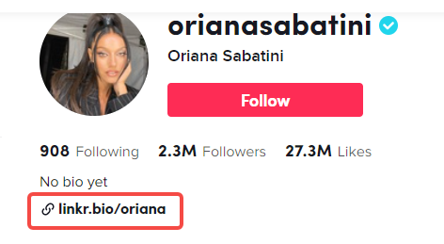

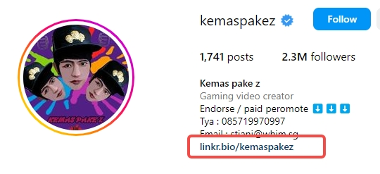

Features How does a creator use Linkr to monetize?
Gather Followers
Premium Content /
Goods and Services
Community Engagement
Repurchase
more to come
- A marketplace for
physical products
- Added gamified
shopping features
- Creator-supplier
matching services
- Creator-supplier
matching services
One landing page for all social bios
Mini-website to showcase every side of you
Followers know more of you besides on one social platform

Slide 6
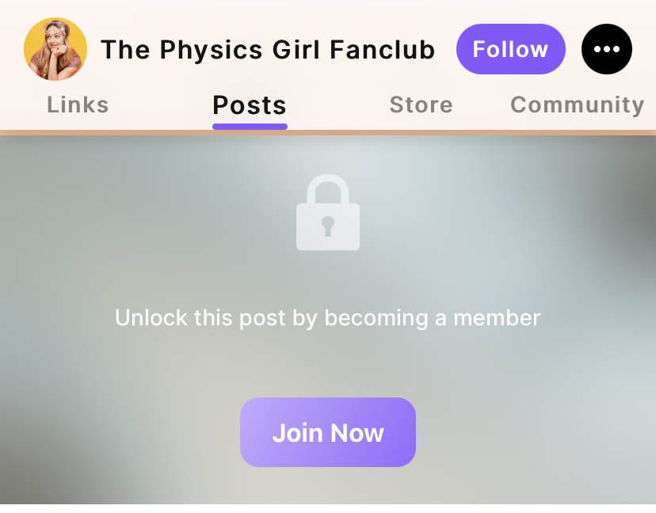
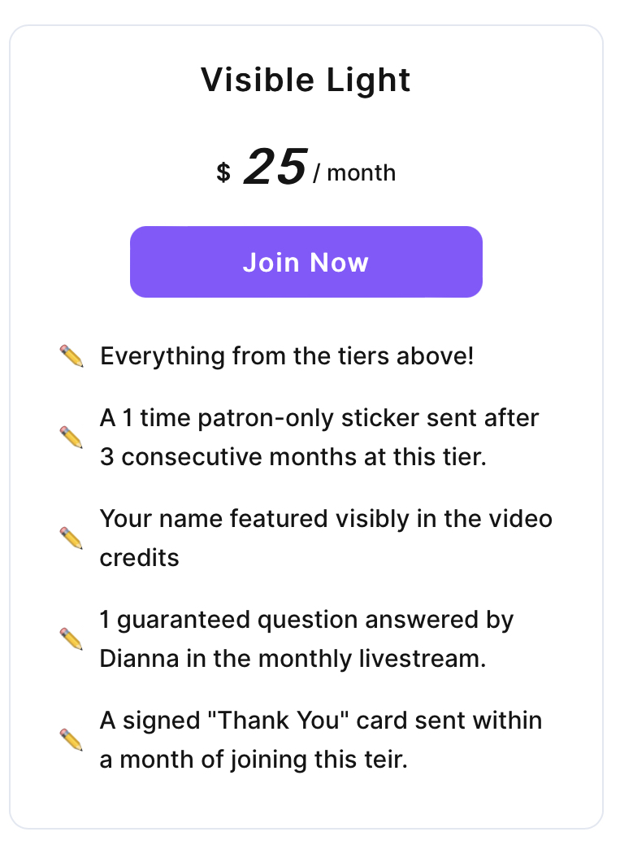
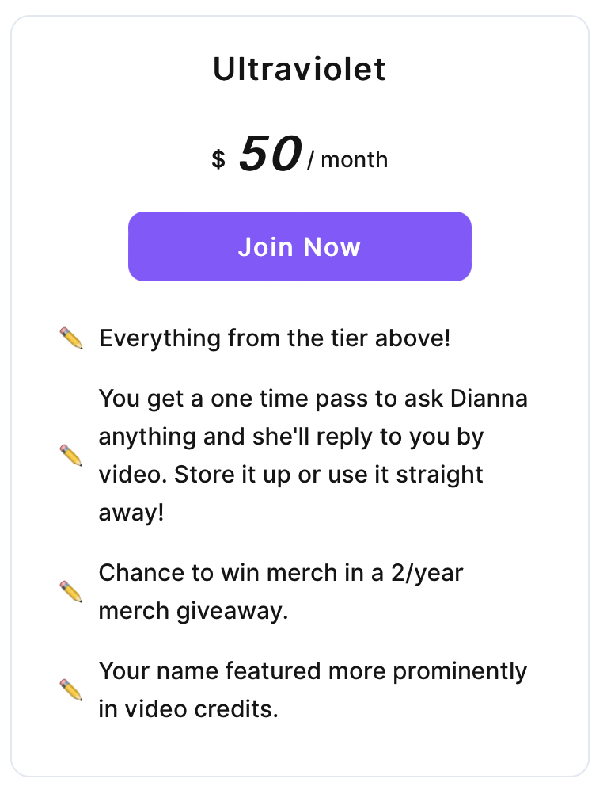
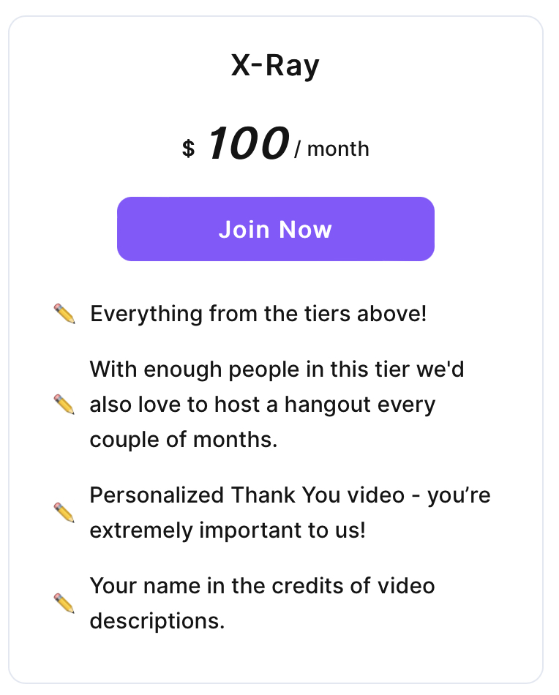
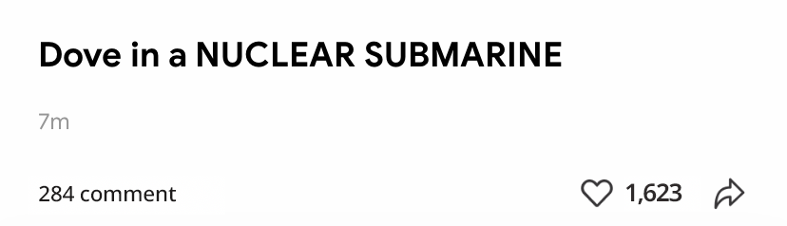
Features How does a creator use Linkr to monetize?
Gather Followers
Premium Content /
Goods and Services
Community Engagement
Repurchase
more to come
- A marketplace for
physical products
- Added gamified
shopping features
- Creator-supplier
matching services
- Creator-supplier
matching services
Premium Content Subscription
100% customizable tiers and benefits
Free and paid content
Friendly engagements
Algo-free
Freedom in creation

Slide 7
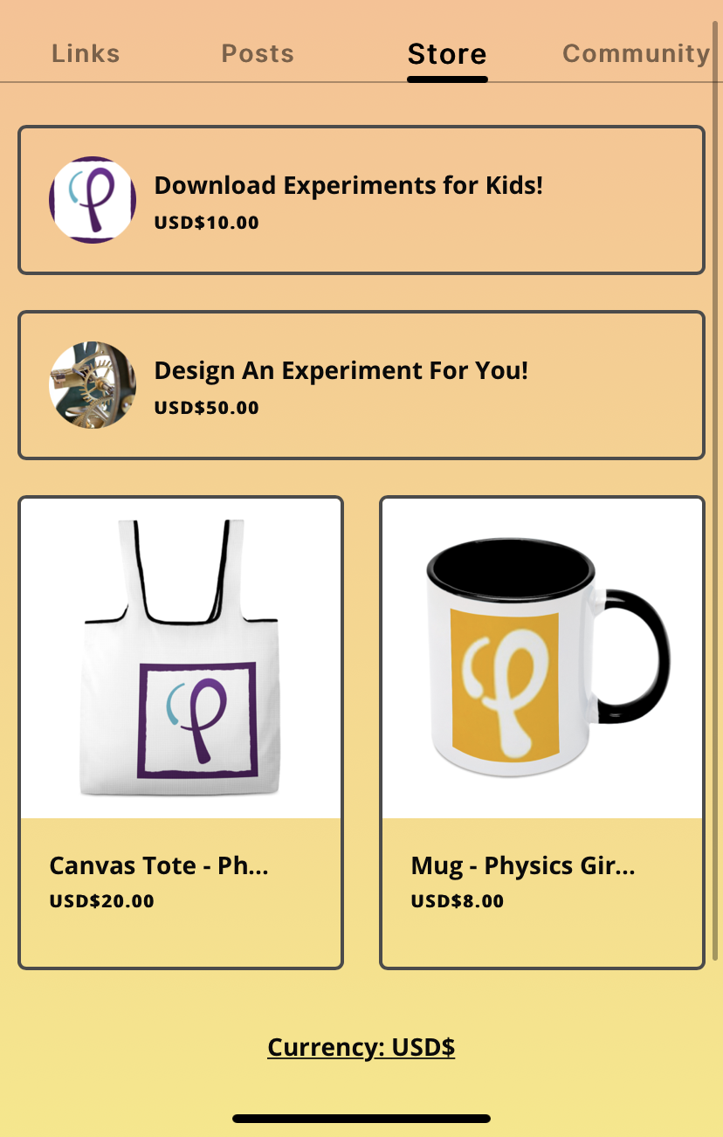
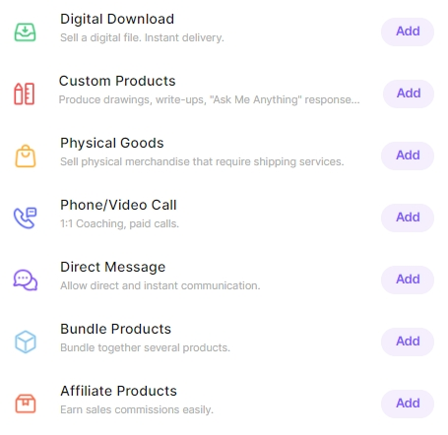
Features How does a creator use Linkr to monetize?
Gather Followers
Premium Content /
Goods and Services
Community Engagement
Repurchase
more to come
- A marketplace for
physical products
- Added gamified
shopping features
- Creator-supplier
matching services
- Creator-supplier
matching services
Goods and Services
Audiobooks, pocasts, exclusive video
Art, prints, choreography
courses, templates, designs
1:1 video call, mock interviews
Avatars, skins, outfits
Merch with logo
and more....

Slide 8
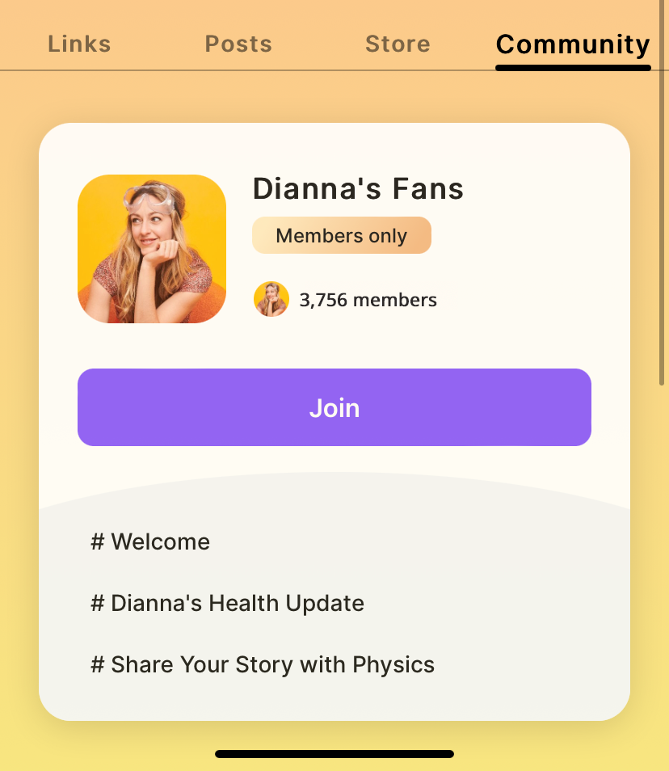
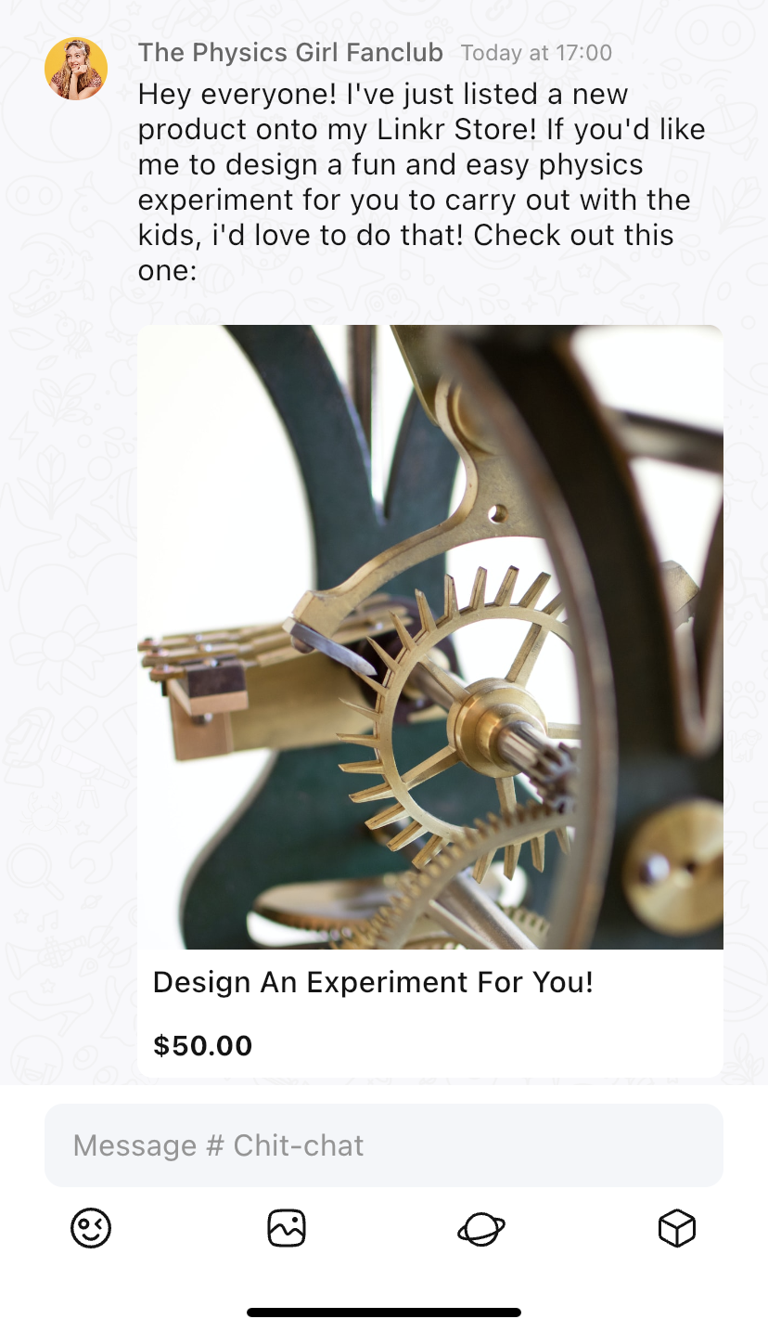
Features How does a creator use Linkr to monetize?
Gather Followers
Premium Content /
Goods and Services
Community Engagement
Repurchase
more to come
- A marketplace for
physical products
- Added gamified
shopping features
- Creator-supplier
matching services
- Creator-supplier
matching services
Creators’ own Community Channel
Public & private channels
Share your updates
Share your new products
Easy engagement with fans
Member management

Slide 9


Features How does a creator use Linkr to monetize?
Gather Followers
Premium Content /
Goods and Services
Community Engagement
Repurchase
more to come
- A marketplace for
physical products
- Added gamified
shopping features
- Creator-supplier
matching services
- Creator-supplier
matching services
Continuous provision of selected products and worldwide delivery.
Brand deals
Print-On-Demand products
Personalized merch

Slide 10
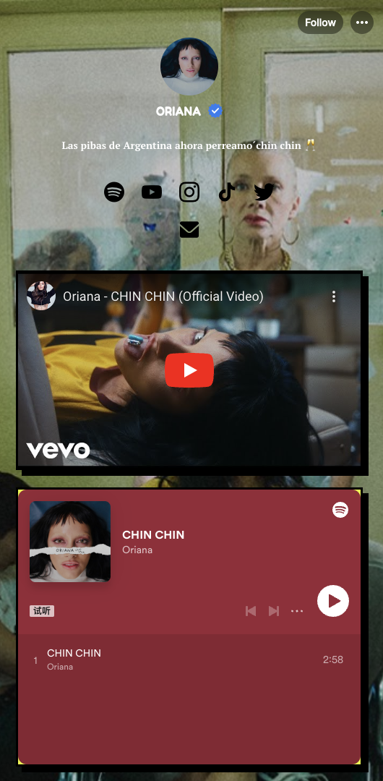
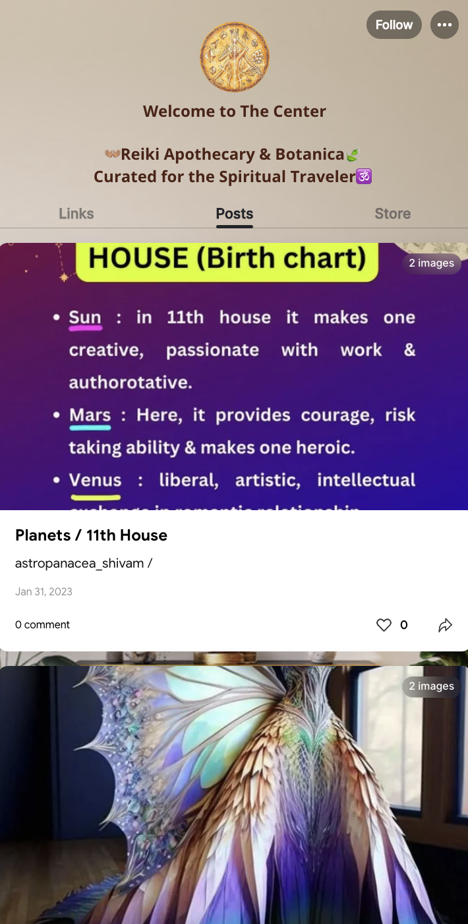
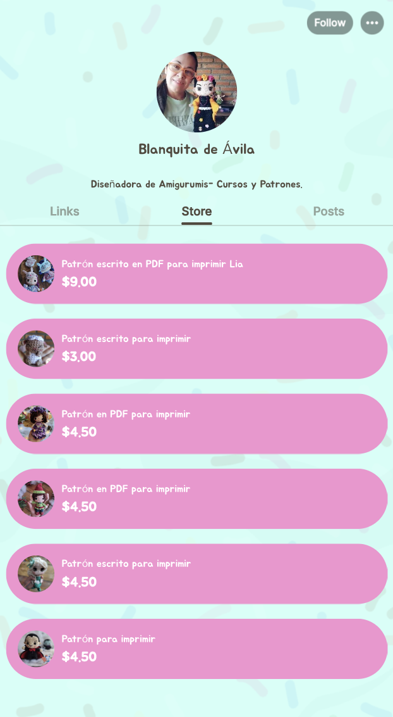
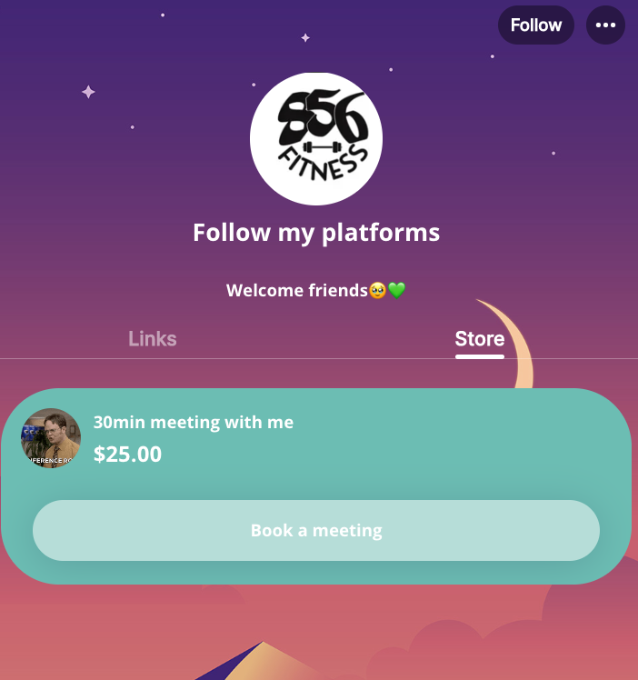
User Cases
Store feature
Fitness Influencer
1.3K followers on ins
Sells a $25 paid meeting
with the influencer
Store feature
Spanish influencer
27K followers on TikTok
Design and sell handmade
in Linker store
Link in bio feature
Fashion influencer
6M followers on ins
314K followers on YouTube
Membership feature
Astrology account
for spiritual traveler

Slide 11



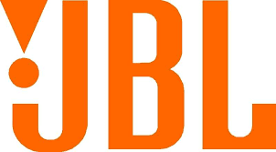



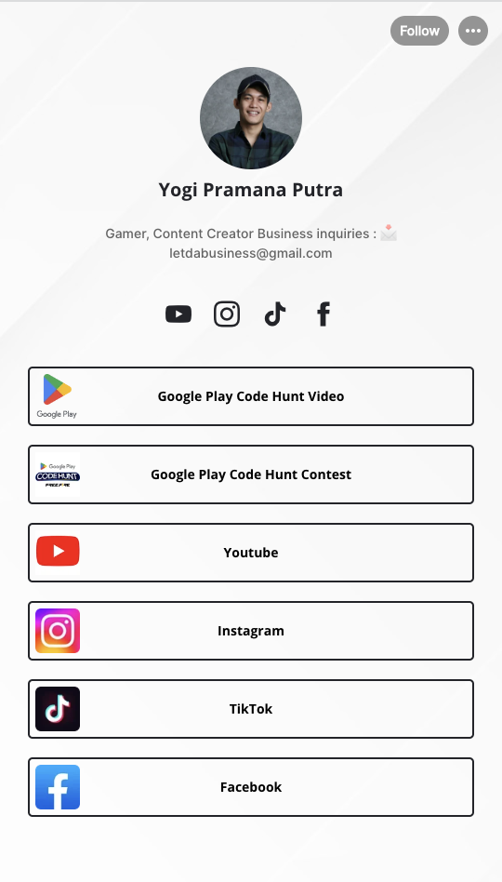
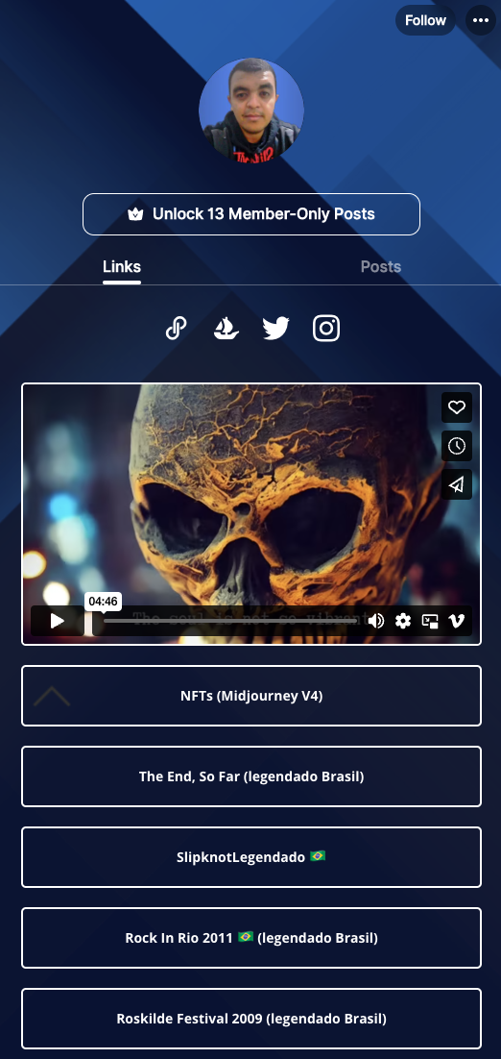
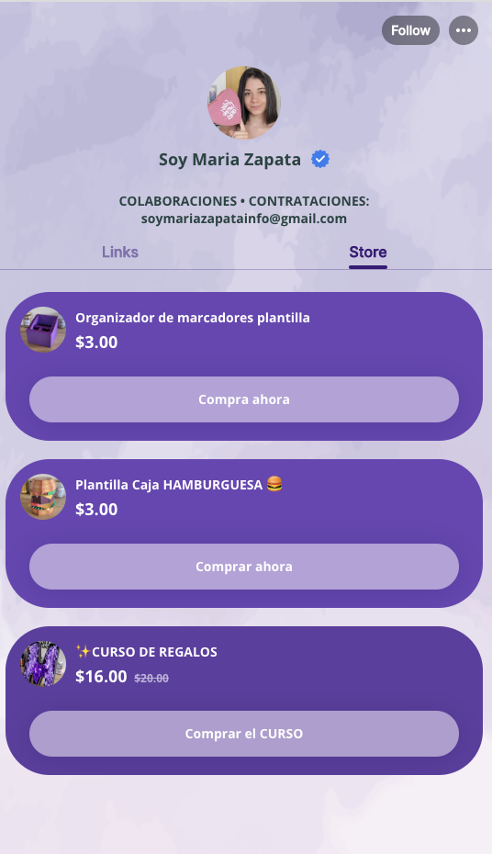



User Cases
待提供
Featured corporate users:
Link in Bio
Posts
Stores
Followers
Followers
Followers
9.4 million
12K
153K
Show his NFT artworks in member-only posts
5.7 million
182K
Sell handmade as a designer
4.7 million
Gamer
Singer
Influencer

Slide 12














Competitive Edge
Features
Link in Bio
Audience Engagement
Digital Merchandise
Exclusive Community
Membership
Physical Merchandise
Ads impact | Coming soon
Customized link in bio
Replaces
$9/mo
8% Rev
Different forms of posting methods
Replaces
Storefront features
Replaces
% +$29/mo
$89/mo
Community creation and maintenance
Replaces
Audience Analytics
Replaces
up to $12.5k/mo
You’d spend otherwise above $1500
All on Linkr
Better Good No
$4.99/mo
Note: for each product, we choose the Pro version as pricing benchmark
Notes:
https://www.cuspera.com/compare/linktree-vs-gumroad/5022/5406

Slide 13
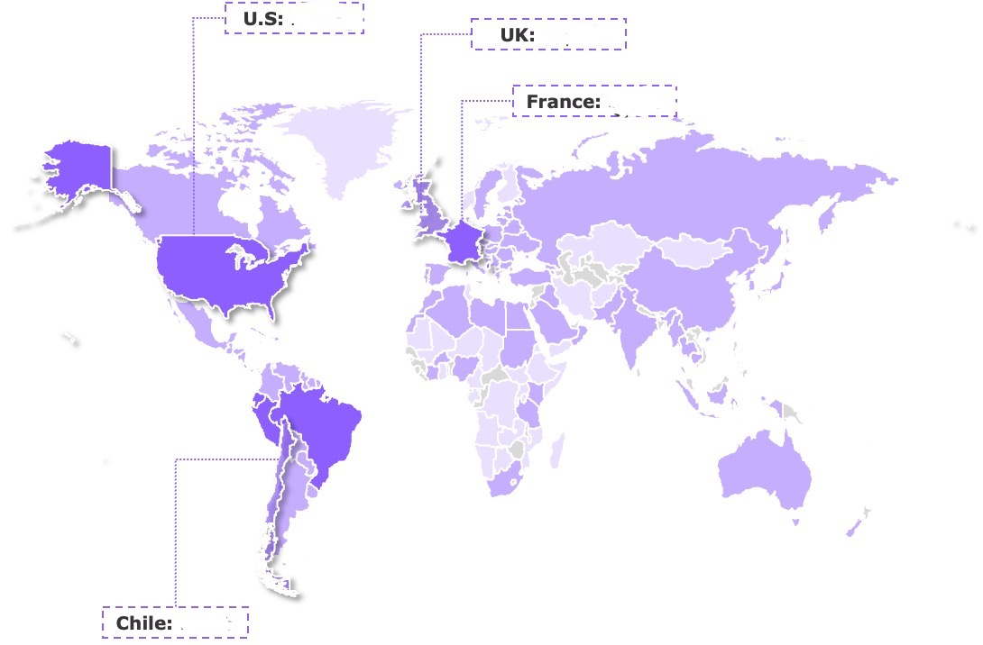
Global Presence
Covering most developed countries
U.S: 2.1%
UK: 1.4%
Used in over
200+ countries
5M+
registered users
France: 2.4%
3M+
daily visits
~1B
fans
Chile: 1.8%

